Slide 1
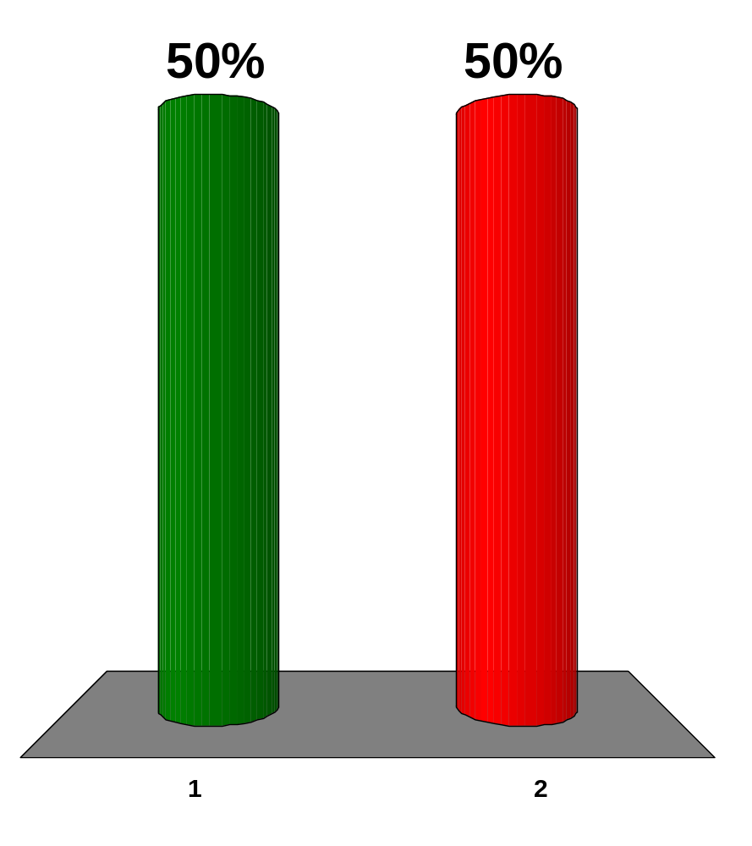
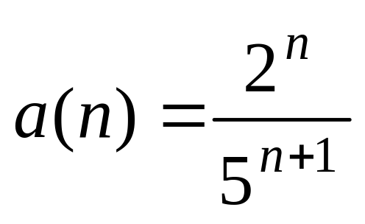
Determine whether the sequence converges or diverges.
converges
diverges

Slide 2
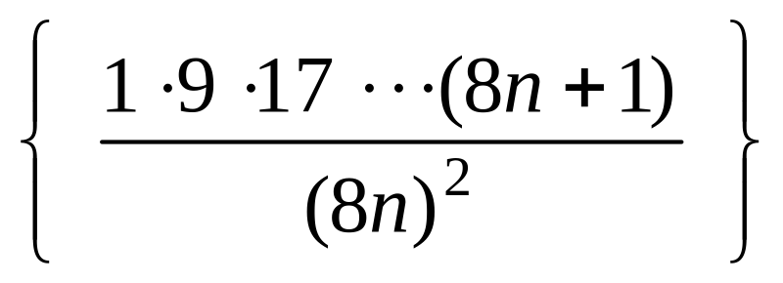
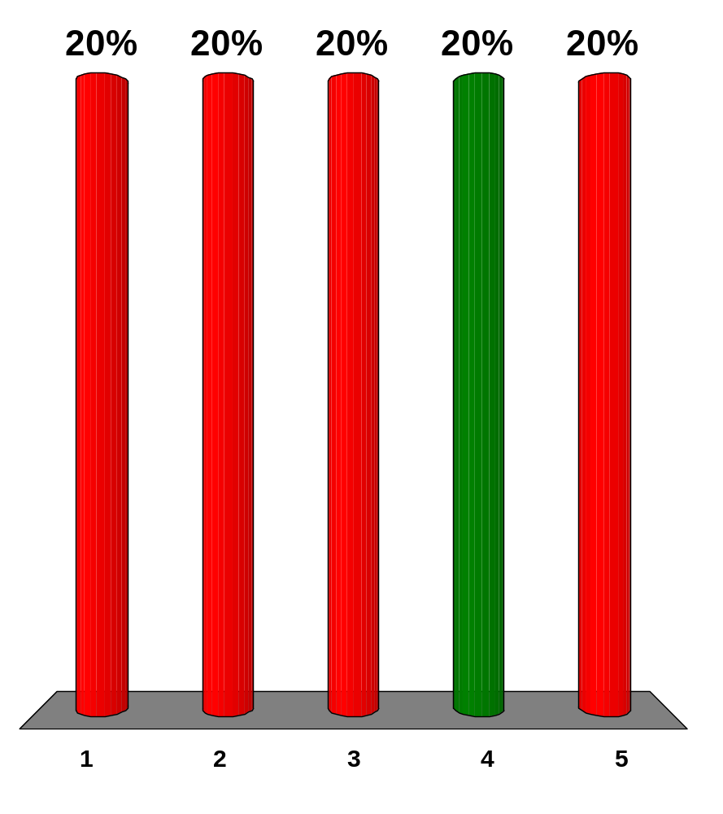
Find the value of the limit for the sequence given.
π
-1
3
0
1

Slide 3
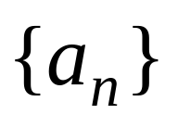
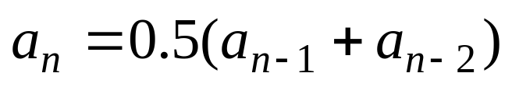

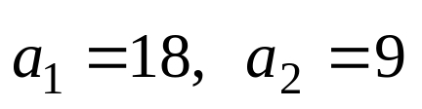
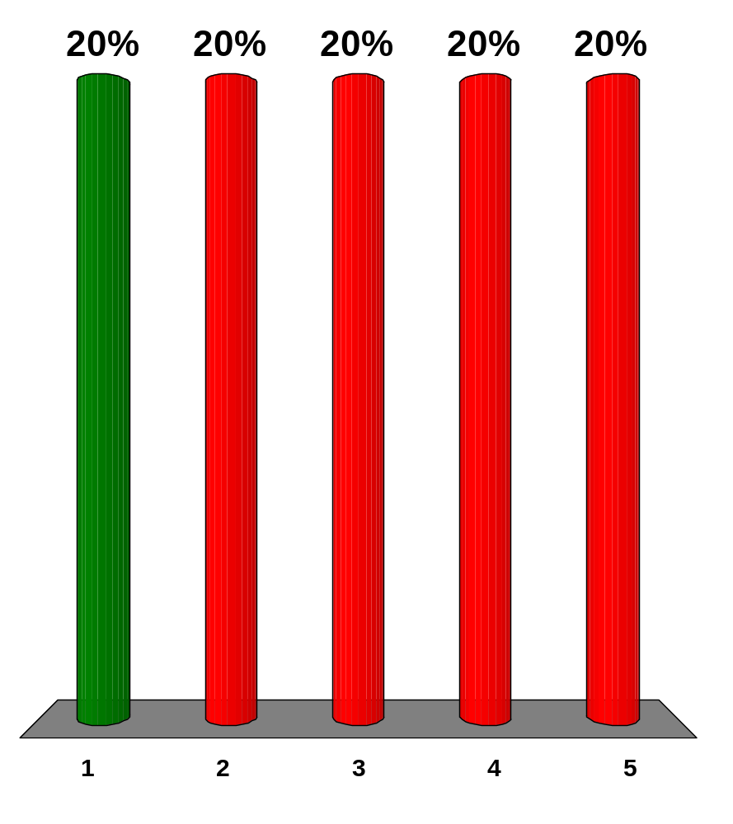
A sequence is defined recursively by the equation for where
.
Use your calculator to guess the limit of the sequence.
12
13
6
17
26

Slide 4
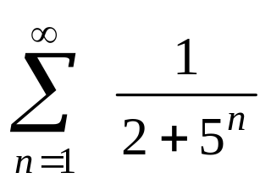
Find the partial sum S₇ of the series .
S₇ = 0.18976
S₇ = 0.18985
S₇ = 1.60976
S₇ = 0.18975
S₇ = 0.19176

Slide 5
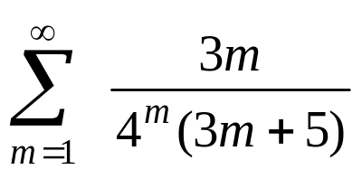
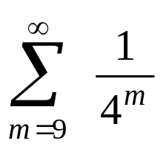
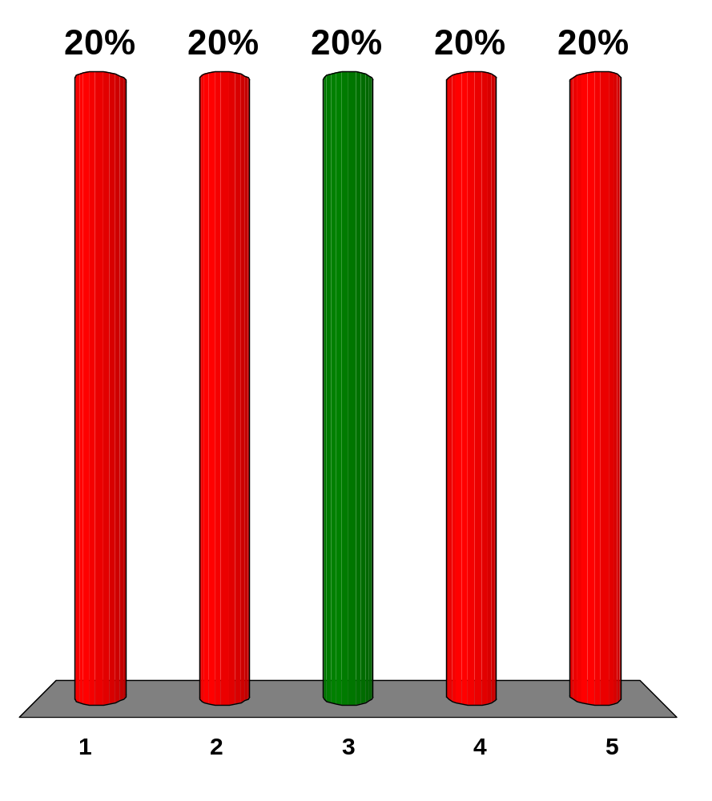
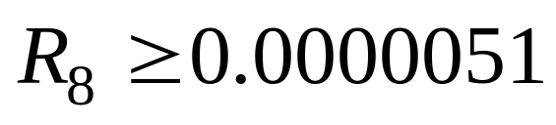
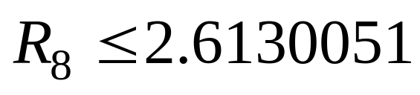
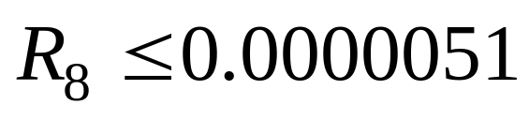
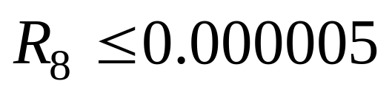
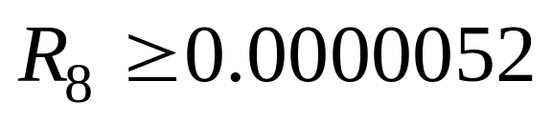
Given the series estimate the error in using the partial sum S₈ by comparison with the series .
x
x
x
x
x

Slide 6
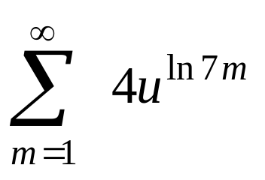
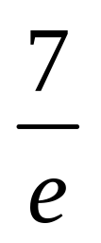
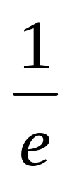
Find all positive values of u for which the series converges.
u < 4
4 < u <
u > 7
0 < u <
u > ln7

Slide 7
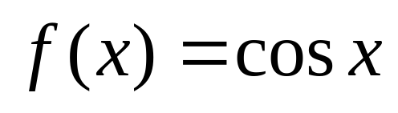
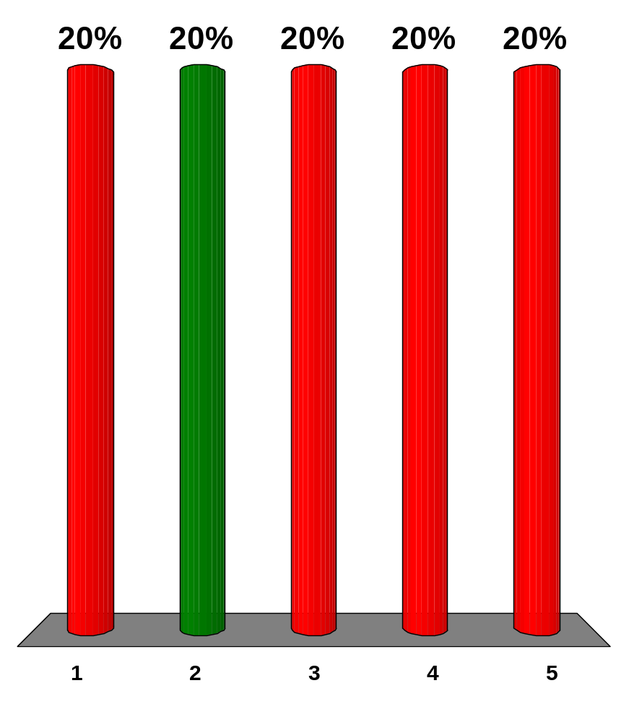
Evaluate the function by a Taylor polynomial of degree 4 centered at a = 0, and x = 2.
0.67
-0.33
-1.33
0.28
-0.44

Slide 8
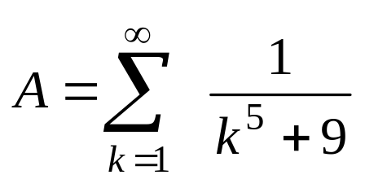
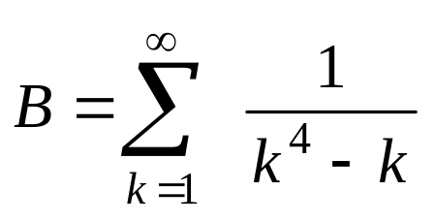
Given the series: and
Both series are convergent.
Both series are divergent.
Series A diverges by the Integral Test.
Series B and A converges by the Limit Comparison Test.
Series B diverges by the Integral Test.

Slide 9
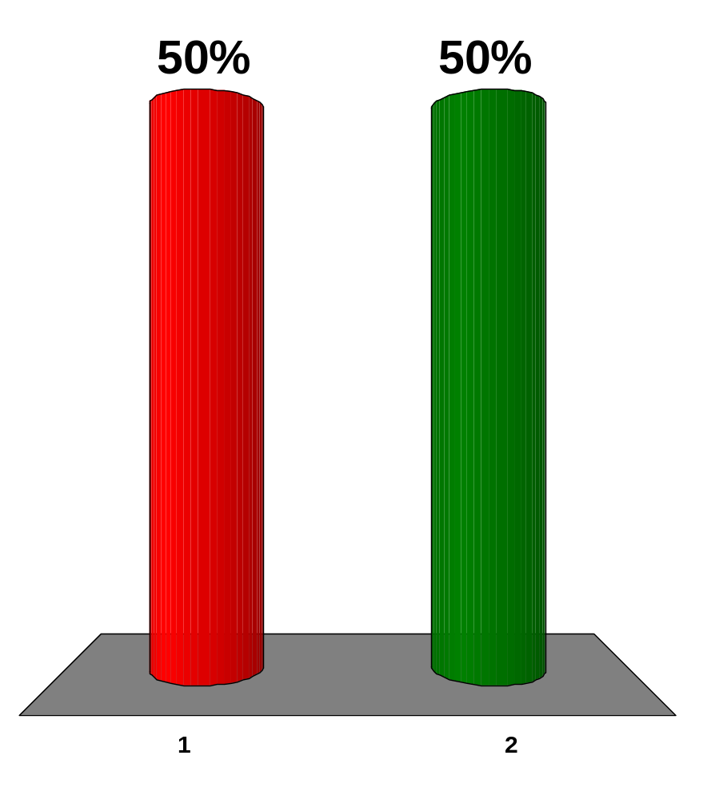
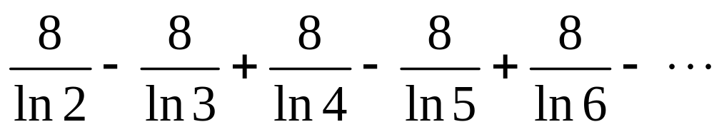
Test the series for convergence or divergence.
the series is divergent
the series is convergent

Slide 10
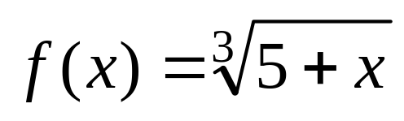
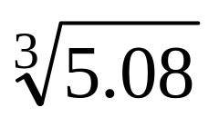
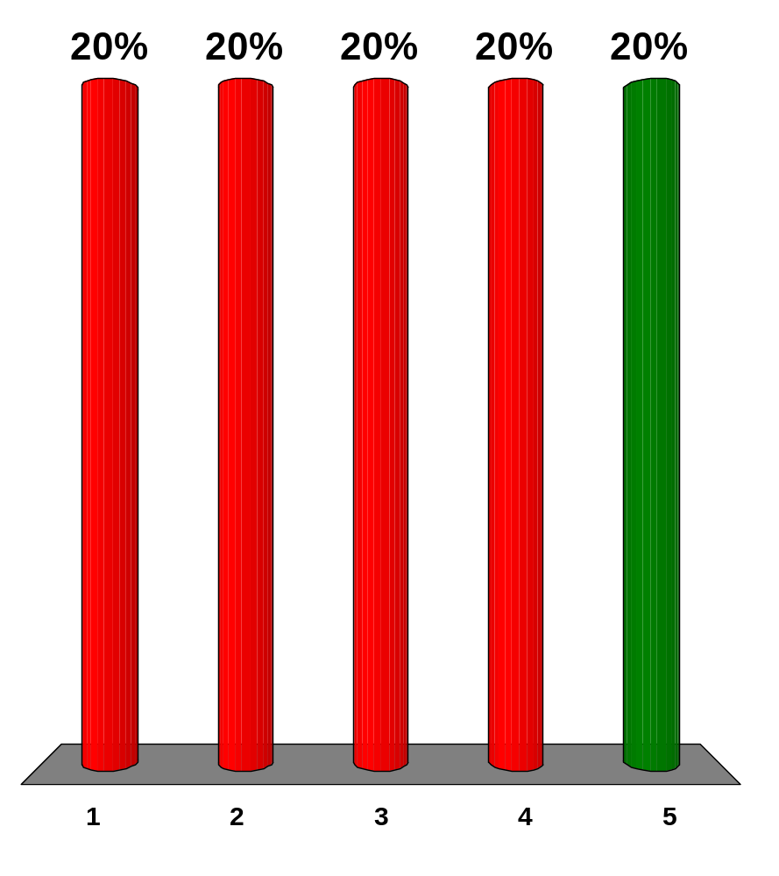
Use the power series for to estimate correct to four decimal places.
1.7156
1.7189
1.7195
1.7200
1.7190

Slide 11
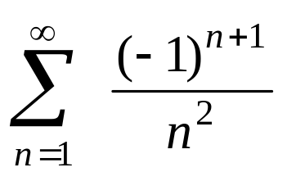
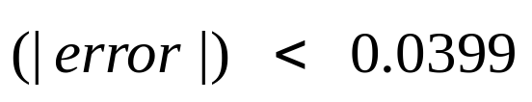
How many terms of the series do we need to add in order to find the sum to the indicated accuracy?
,
n = 12
n = 5
n = 13
n = 6
n = 8

Slide 12
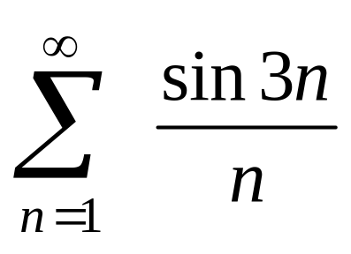
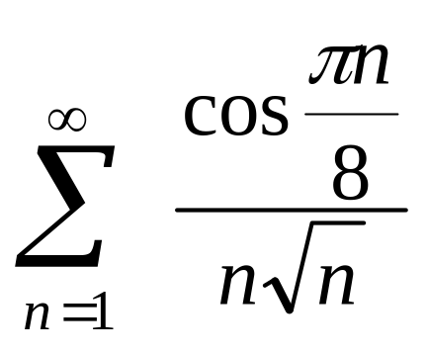
Which of the given series are absolutely convergent?
x
x

Slide 13
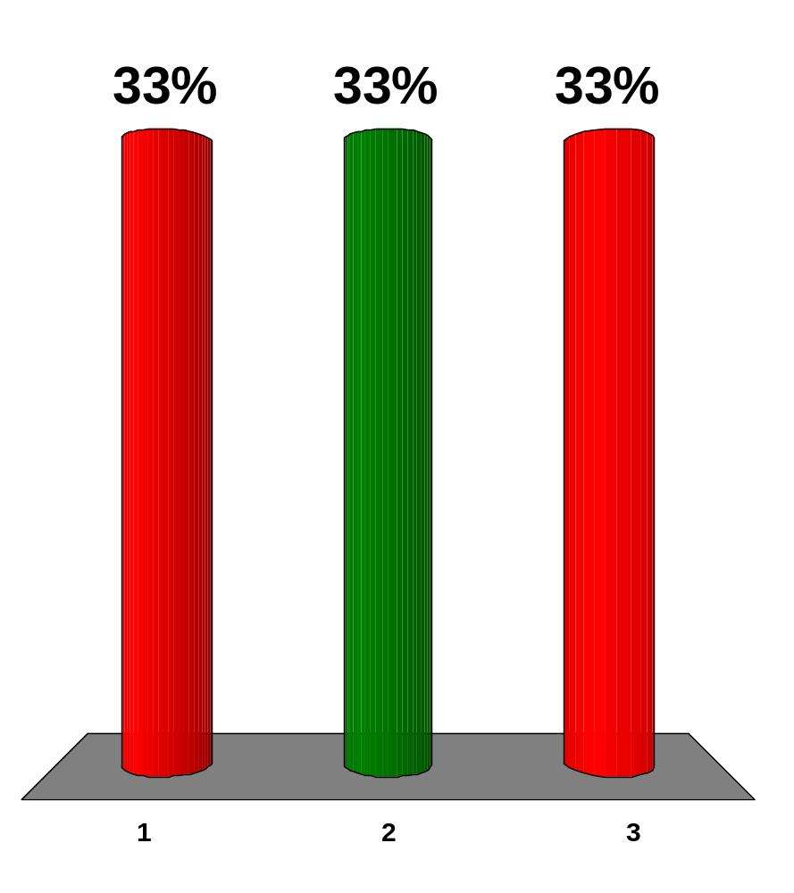
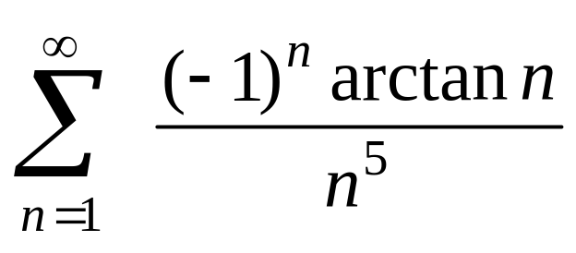
Determine whether the series is absolutely convergent, conditionally convergent, or divergent.
divergent
absolutely convergent
conditionally convergent

Slide 14
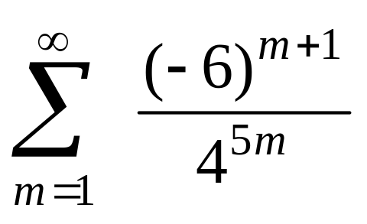
Test the series for convergence or divergence.
The series is convergent
The series is divergent

Slide 15
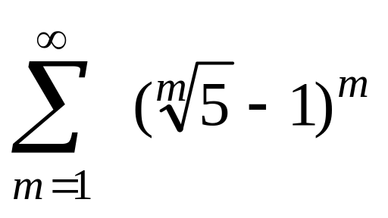
Test the series for convergence or divergence.
The series is divergent
The series is convergent

Slide 16
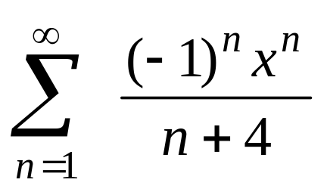
Find the interval of convergence of the series.
[-1, 1)
[-1, 1]
(-1, 1]
(-1, 1)
diverges everywhere

Slide 17
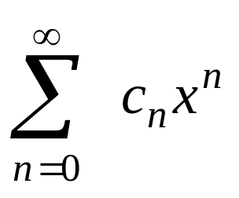
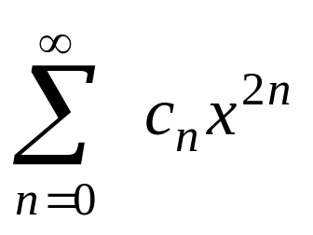
Suppose that the radius of convergence of the power series is 16.
What is the radius of convergence of the power series ?
256
4
1
16
252

Slide 18
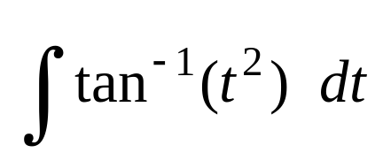
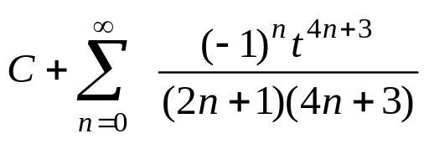
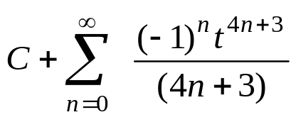
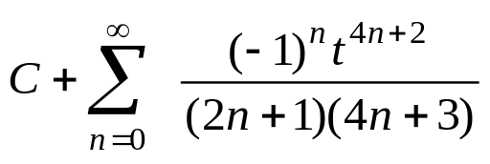
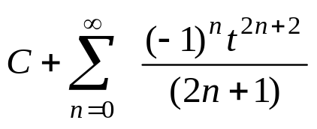
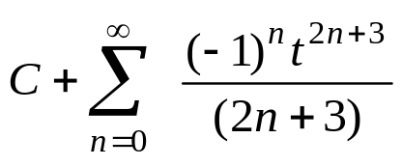
Evaluate the indefinite integral as a power series.
x
x
x
x
x

Slide 19
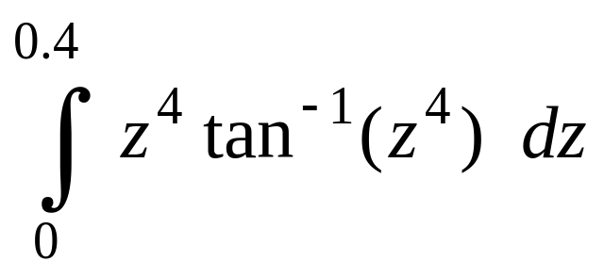
Use a power series to approximate the definite integral.
0.4
0.000029
1.400262
1.399738
1.004262

Slide 20
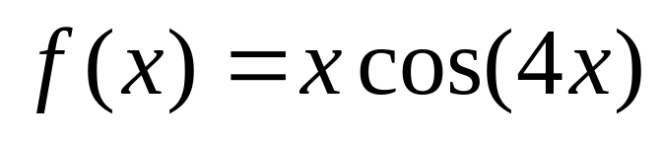
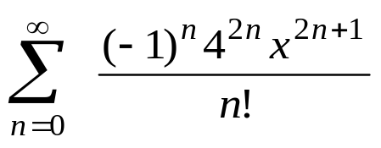
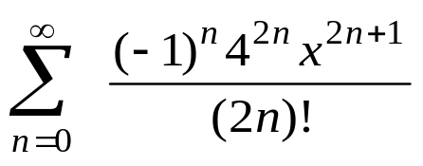



Find the Maclaurin series for ƒ(x) using the definition of the Maclaurin series.
x
x
x
x
x

Slide 21






Find the value of the limit of the sequence defined by .
1.
2.
3.
4.
5.
x
x
x
x
x

Slide 22






Find the value of the limit of the sequence defined by .
1.
2.
3.
4.
5.
x
x
x
x
x

Slide 23






Find the value of c.
2.
1.
3.
4.
5.
x
x
x
x
x

Slide 24



Given the two series and determine whether each series is convergent or divergent and choose the correct statement.
Both series are divergent.
Series A is convergent, series B is divergent.
Both series are convergent.
Series A is divergent, series B is convergent.

Slide 25

Find the partial sum of the series .
S₇ = 0.46301
S₇ = 0.47999
S₇ = 2.276
S₇ = 0.466
S₇ = 0.566

Slide 26



Given the series: and
Determine whether each series is convergent or divergent.
A is convergent, B is divergent.
A is divergent, B is convergent.
Both series are convergent.
Both series are divergent.

Slide 27


Find the interval of convergence of the series.
(-8, 8]
(-1,1)
[-1, 1]
[-8, 8]
[-8, 8)
diverges everywhere

Slide 28

Find the radius of convergence of the series.
R = ∞
R = 0
R = ⅓
R = 1
R = 3

Slide 29


Find the interval of convergence of the series.
(2, 14]
(-14, -2)
[-1,1]
(-8, 6]
[-14, -2)
diverges everywhere

Slide 30






Find a power series representation for
1.
2.
3.
4.
5.
x
x
x
x
x

Slide 31






Find a power series representation for the function.
1.
2.
3.
4.
5.
x
x
x
x
x

Slide 32

Use series to approximate the definite integral to within the indicated accuracy.
0.1249
0.0125
0.1449
0.0625
0.0825

Slide 33

Use series to evaluate the limit correct to three decimal places.
114.133
114.333
34.3233
115.933
118.933

Slide 34

Use the binomial series to expand the function as a power series. Find the radius of convergence.
| x | < 8
| x | < 10
| x | < 1
| x | < 0.1
| x | < 1.8

Slide 35

Use the binomial series to expand the function as a power series. Find the radius of convergence.
| x | < 8
| x | < 1
| x | < 4
| x | < 10
| x | < 1.8

Slide 36






Find the Taylor polynomial T₃ for the function ƒ at the number a = 1.
x
x
x
x
x

Slide 37






Find the Taylor polynomial T₃ for the function ƒ(x) at the number a = 9.
x
x
x
x
x

Slide 38


Use Taylor's Inequality to estimate the accuracy |R₂| of the approximation ƒ(x) at the number a = 1, when .
1.0407
0.5407
1.5407
1.7407
1.8407

Slide 39

Estimate correct to five decimal places.
1.07358
1.57358
0.57358
1.77358
2.57358

Slide 40

Determine whether the sequence converges or diverges.
converges
diverges

Slide 41
When money is spent on goods and services, those that receive the money also spend some of it. The people receiving some of the twice-spent money will spend some of that, and so on. Economists call this chain reaction the multiplier effect. In a hypothetical isolated community, the local government begins the process by spending D dollars.
Suppose that each recipient of spent money spends 100c% and saves 100s% of the money that he or she receives. The values c and s are called the marginal propensity to consume and the marginal propensity to save and, of course, c + s = 1. The number k = 1/s is called the multiplier. What is the multiplier if the marginal propensity to consume is 80%?
6
4
5
7
3

Slide 42

Determine whether the series converges or diverges.
neither
converges
diverges

Slide 43






Use multiplication or division of power series to find the first three nonzero terms in the Maclaurin series for the function.
x
x
x
x
x

Slide 44

The following table contains the evaluation of the Taylor polynomial centered at a = 1 for . What is the degree of this polynomial?
x | T(x)
0.5 | 1.88
0.7 | 1.42
1.7 | 0.45
2.8 | -3.39
3 | -5.00
3
2
1
5
4

Slide 45

If $600 is invested at 4% interest, compounded annually, then after n years the investment is worth dollars.
Find the size of investment after 7 years.
$789.56
$430.21
$1,321.06
$1,230.81
$1,860.81

Slide 46






Find the value of the limit of the sequence defined by .
1.
2.
3.
4.
5.
x
x
x
x
x

Slide 47


Let and .
Compare A and B.
A ≥ B
A ≤ B
A < B
A > B
A = B

Slide 48



Given the two series and determine whether each series is convergent or divergent and choose the correct statement.
Series A is divergent, series B is convergent.
Both series are convergent.
Series A is convergent, series B is divergent.
Both series are divergent.

Slide 49


Which of the given series is (are) convergent?
x
x

Slide 50

Test the series for convergence or divergence.
the series is divergent
the series is convergent

Slide 51

Estimate correct to five decimal places.
1.54464
1.04464
0.54464
2.04464
3.54464

Slide 52

For which positive integers k is the series convergent?
k ≥ 1
k ≤ 0
k ≥ 0
k ≥ 6
k ≤ -6

Slide 53

Use the Integral Test to determine whether the series is convergent or divergent.
the series is divergent
the series is convergent

Slide 54
A car is moving with speed 16 m/s and acceleration 6m/s² at a given instant. Using a second-degree Taylor polynomial, estimate how far the car moves in the next second.
19.5 m
19 m
20 m
25.5 m
30 m

Slide 55






Find the Taylor polynomial T₃ for the function ƒ at the number a = 1.
x
x
x
x
x

Slide 56

Approximate the sum to the indicated accuracy. (five decimal places)
0.99219
0.99249
0.97269
0.99259
0.98259

Slide 57

Determine whether the series is absolutely convergent, conditionally convergent, or divergent.
divergent
absolutely convergent
conditionally convergent

Slide 58


Determine whether the series is absolutely convergent, conditionally convergent, or divergent.
absolutely convergent
divergent
conditionally convergent

